Slide 1
Big O and Data Structures
Lesson 22.3

Slide 2


Outline
Project Check-In
Computer Science Context
Big O Notation
Data Structures
Arrays
Hash Tables
Stacks/Queues
Sets
Linked Lists
Binary Trees & Binary Search Trees
Dictionaries
Graphs

Slide 3
Project Check-In

Slide 4

Project Status
Smooth sailing?
Notes:
shutterstock_705783685

Slide 5

Project Check-In: Deliverable #1 is Due by the End of Today’s Class
Submit by the end of the day!
Please send the following to your Instructor and TAs:
Overview of intended application
Detailed screen-by-screen UI layouts with annotations
Breakdown of group member roles
Screenshot of project management tool

Slide 6
Computer Science Context

Slide 7
Welcome to…
Computer Science Fundamentals!

Slide 8

Remember…
Computer science fundamentals
Fundamentals aren’t the “easy” computer science stuff
Rather, they are the fundamental concepts that underlie all of the work we’ve been doing to date
The biggest takeaway is to understand that there are different tools to increase computational efficiency

Slide 9
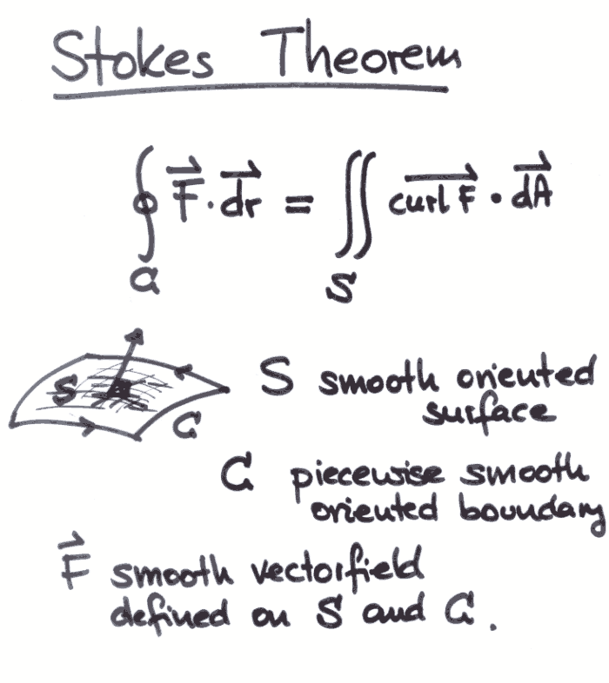
Fundamentals
Remember this stuff? Yeah, me neither.

Slide 10
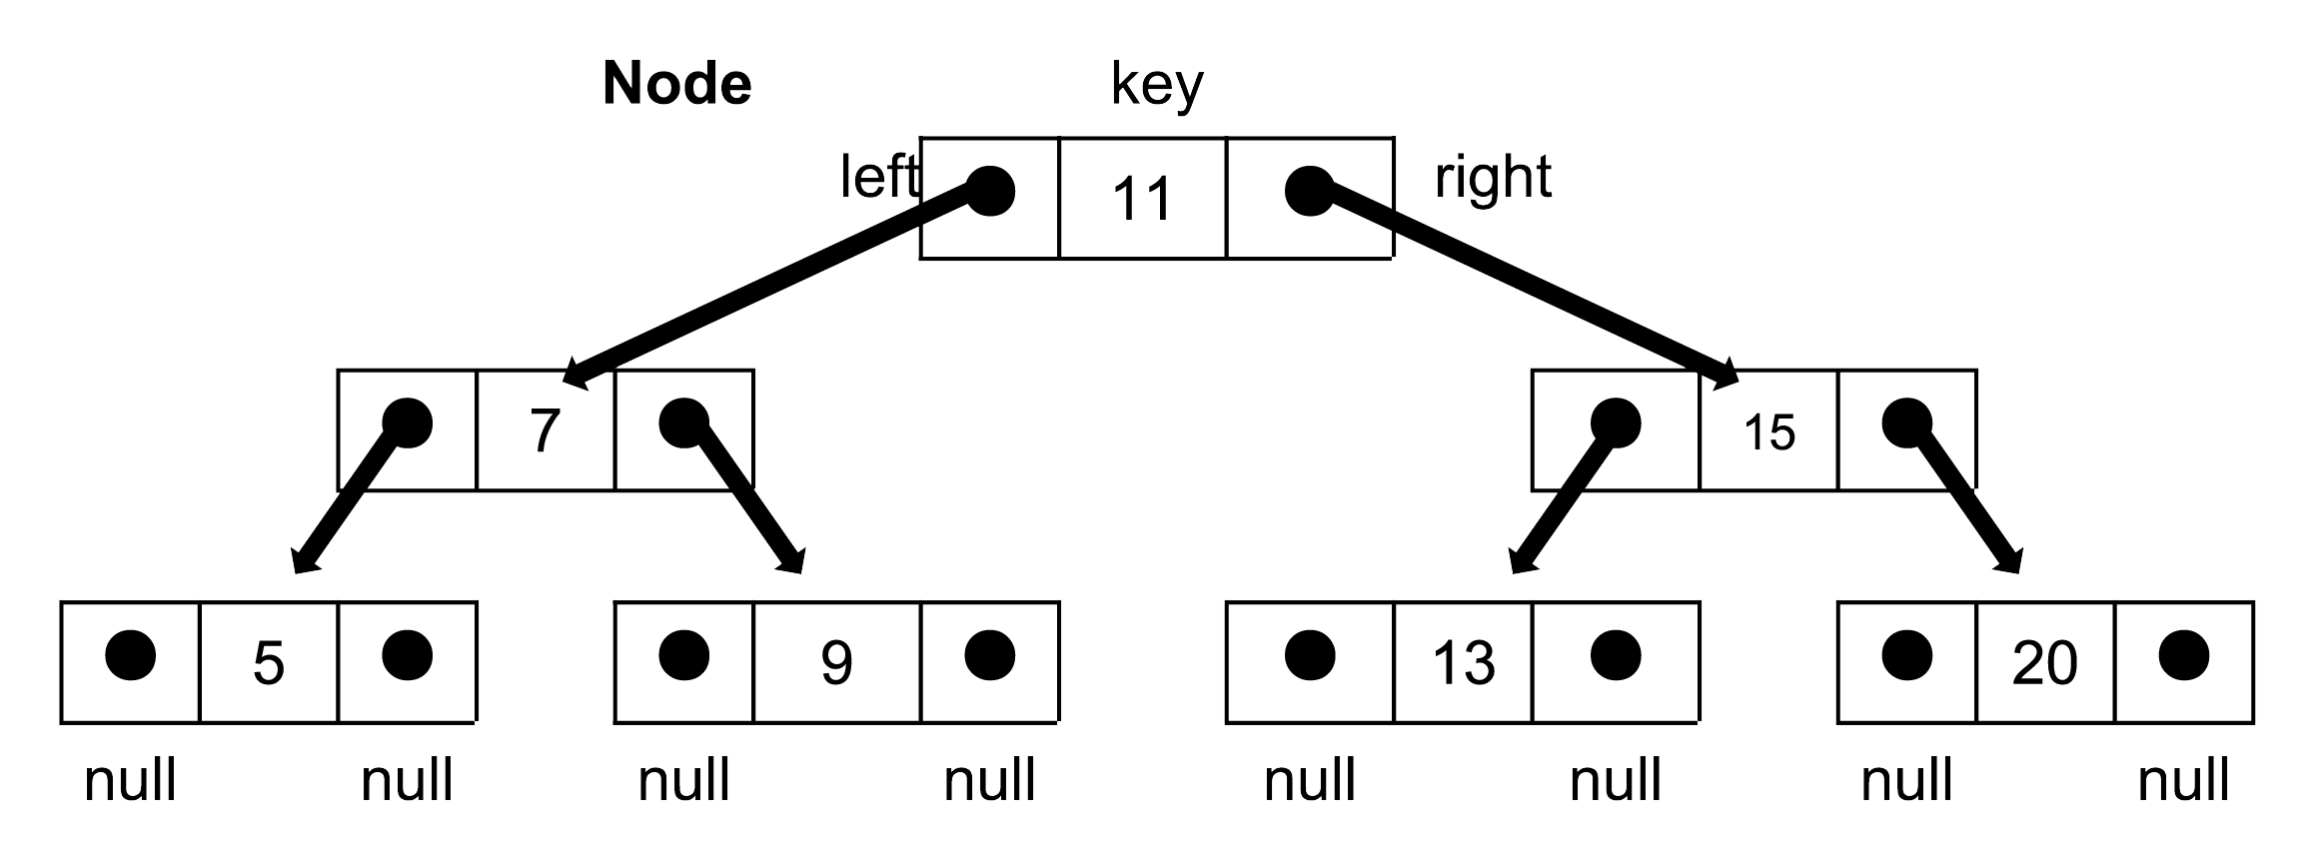
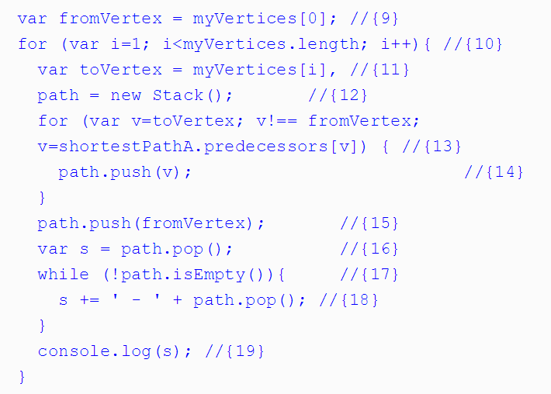
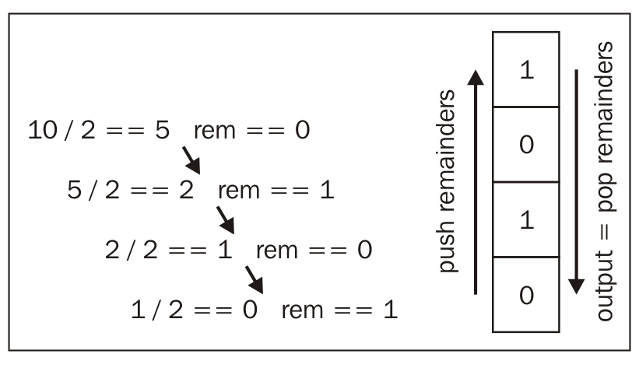
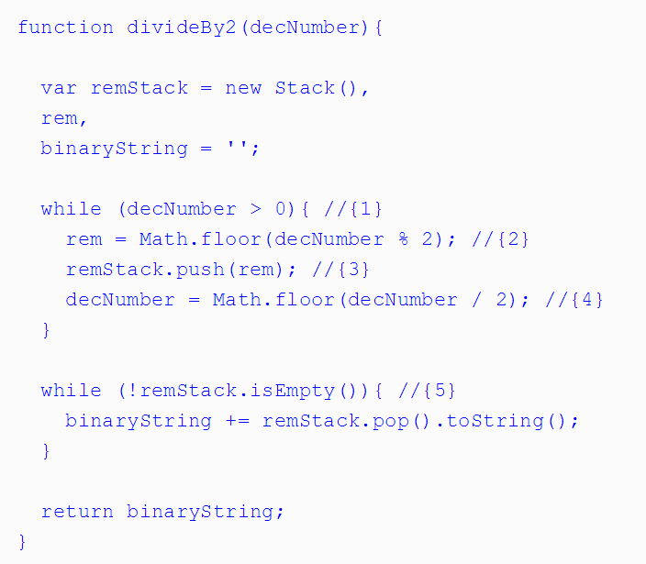
It Gets Hairy and Scary
Notes:
The amount of computer science content dwarfs everything we’ve learned so far
We will actually learn about the above on Thursday (it’s not so scary)

Slide 11
Be Wary of Imposter Syndrome Don’t let the hard stuff scare you.

Slide 12
Why Cover This?
01
This is the interview. It is how you get the job.
02
Performance is massively important to computing. Understanding the implications and options you have is essential
03
The computational challenges force you to deepen your understanding

Slide 13

Bottom Line
My goal is to give you the terminology and the concepts.
I want to give you enough insight so you can understand the context of interview questions that come your way.
And to encourage those of you who are into math to take a second look!

Slide 14
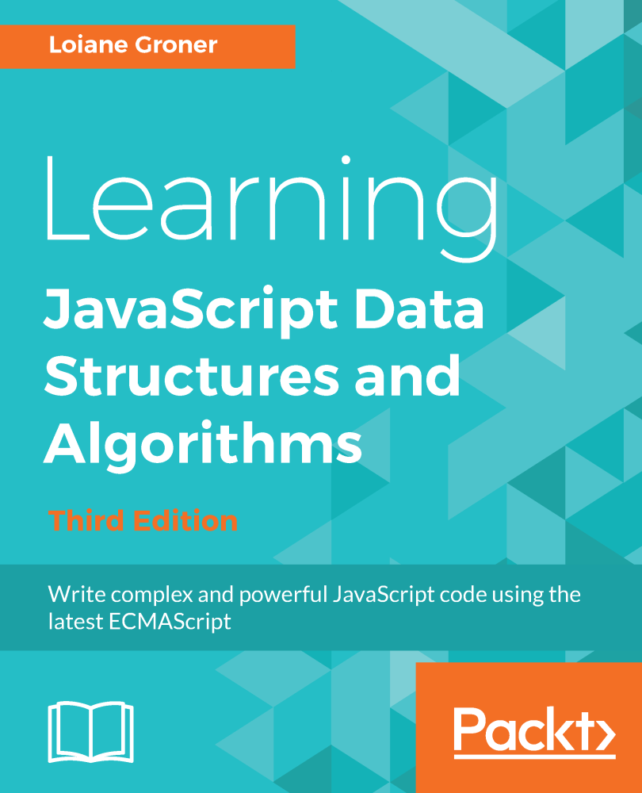
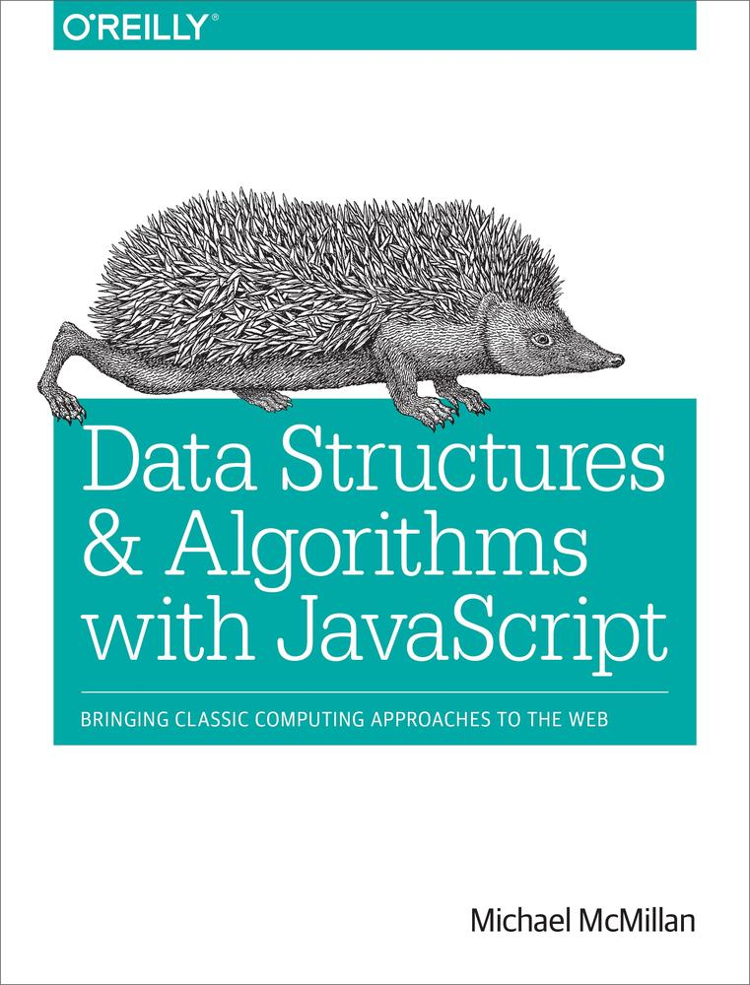
Going Deep
For those who dare dive deeper
Learning JavaScript Data Structures and Algorithms—Third Edition
by Loiane Groner
Publisher: Packt Publishing
Release Date: April 2018
Data Structures and Algorithms with JavaScript
by Michael McMillan
Publisher: O'Reilly Media, Inc.
Release Date: March 2014

Slide 15
Efficiency

Slide 16

What does “Efficient” Mean?
We talk a lot about efficiency. But what exactly does “efficient” mean?

Slide 17
Fewer Steps = Faster Code
Number of Steps ~ Efficiency

Slide 18
More Steps = Less Efficient
Fewer Steps = More Efficient

Slide 19
What’s a Step?
A step is an instruction to the computer.
All computations boil down to a handful of basic steps.
Arithmetic (+, *, etc.)
Assignment (var x = 42;)
Boolean tests (x === 42)
Reading from memory
Writing from memory

Slide 20
What’s a Step?
Each of these counts as a step.
Notes:
shutterstock_1051979417

Slide 21
What’s a Step?
Fewer steps = faster code

Slide 22
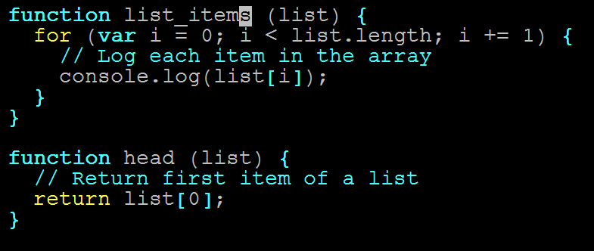
Pop Quiz (!)
Which function is more efficient?
Which has fewer steps?

Slide 23
Count the instructions!

Slide 24
Count Instructions
head = 1 instruction

Slide 25
Count Instructions
list_items = n instructions
…
(n = list.length)

Slide 26
The Verdict
head is more efficient.

Slide 27
The Verdict
But list_items isn’t bad.

Slide 28
Time Complexity

Slide 29
Quantifying Efficiency
head always executes one instruction…

Slide 30
Quantifying Efficiency
…no matter how long the array is.

Slide 31
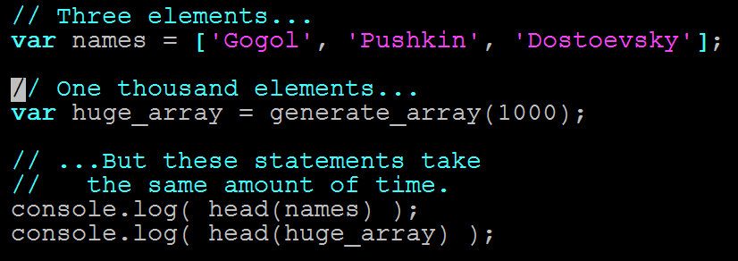
Quantifying Efficiency
head takes the same amount of time on any input

Slide 32
Quantifying Efficiency
list_items needs n instructions

Slide 33
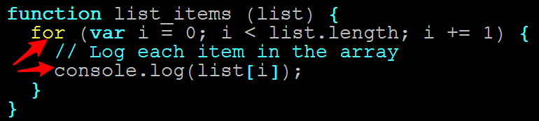
Quantifying Efficiency
One console.log per item:

Slide 34
Quantifying Efficiency
console.log is fast…

Slide 35
Quantifying Efficiency
…but not free.

Slide 36
Quantifying Efficiency
Longer arrays = more time

Slide 37
Quantifying Efficiency
Double array length = Double time
Triple array length = Triple time

Slide 38
Quantifying Efficiency
In other words…

Slide 39
Quantifying Efficiency
The running time of head and list_items scale differently.

Slide 40
Time complexity = the rate at which algorithm slows as input grows.

Slide 41
Quantifying Efficiency
head is always one instruction.

Slide 42
Running time does not slow for larger inputs.

Slide 43
Quantifying Efficiency
In other words…

Slide 44
Quantifying Efficiency
The running time of head is constant.

Slide 45
Quantifying Efficiency
list_items takes n instructions

Slide 46
Running time depends on array.

Slide 47
Quantifying Efficiency
Double array length, double time,
etc…

Slide 48
Quantifying Efficiency
Running time increases linearly with array length.

Slide 49
Big O Notation

Slide 50
Big O
Big O Notation lets us describe how running time scales when we increase the input size (N).
It is denoted with a big O and the growth factor in parentheses.
Examples:
head => O(1) Grows like “1” (i.e., running time never grows)
list_items => O(N) Grows like “n” (i.e., gets bigger as N gets bigger)

Slide 51
Big O
There are other Big O “classes.”

Slide 52
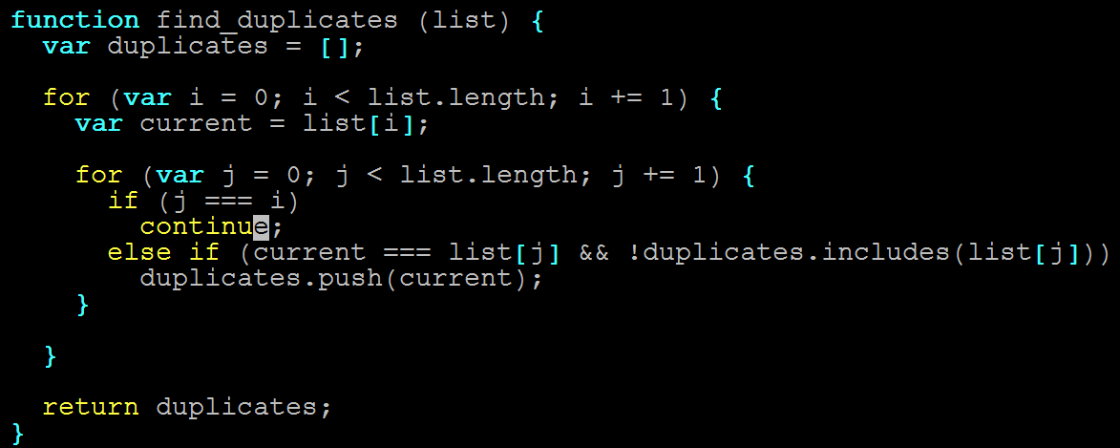
Big O
N steps for each of the N items in list (!)

Slide 53
Big O
2x length = 4x time
3x length = 9x time
nx length = n² time

Slide 54
Big O
Running time grows as square of input.

Slide 55

Big O
find_duplicates => O(n²)
Quadratic time complexity

Slide 56
Big O:
MAJOR INSIGHT!

Slide 57
Big O
2 nested | for | loops is often O(N²)

Slide 58
NOT COINCIDENCE!

Slide 59
Big O
3 nested for loops ~ O(n³)
Etc.

Slide 60
Big O:
One More...

Slide 61
Big O
How fast is binary search?
8
3
10
1
6
14
4
7
13

Slide 62
Big O
What is the Big O of binary search?
O(1)
O(n)
O(N²)
Something else?

Slide 63
Big O
Something else? Why?!
Notes:
shutterstock_1051979417

Slide 64
Activity:
Binary search this array by hand, for 3, then 9.
Count the steps.

Slide 65
Activity:
Binary search this array by hand, for 3, then 9.
Count the steps.
Answer: 3 Steps

Slide 66
Big O
Add the digits 11–20. Repeat.

Slide 67
Big O
Add the digits 11–20. Repeat.
Answer: 4 Steps (!)

Slide 68
Much faster than linear.

Slide 69
Big O
(input size)² ~ 2x running time
(input size)³ ~ 3x running time
^{Etc.}

Slide 70
Big O
This is O(log₂N).

Slide 71
Big O
log₂N = how many times do I divide N by 2 to get to 1?

Slide 72
Logarithm Example
What is log₂8?

Slide 73
Logarithm Example
8 / 2 = 4 (1)
4 / 2 = 2 (2)
2 / 2 = 1 (3)

Slide 74
Logarithm Example
log₂8 = 3

Slide 75
Logarithm Example
Don’t worry about it.

Slide 76
Big O Review
head ~ O(1) | Grows like “1” (i.e., 2x input size -> 1x running time)
list_items ~ O(N) | Grows like “N” (i.e., 2x input size -> 2x running time)
find_duplicates ~ O(N²) | Grows like “N^{2”} (i.e., 2x input size -> 4x running time)
binary_search ~ O(log₂N) | Grows like “log₂N” (i.e, (input size)² -> 2x running time)

Slide 77
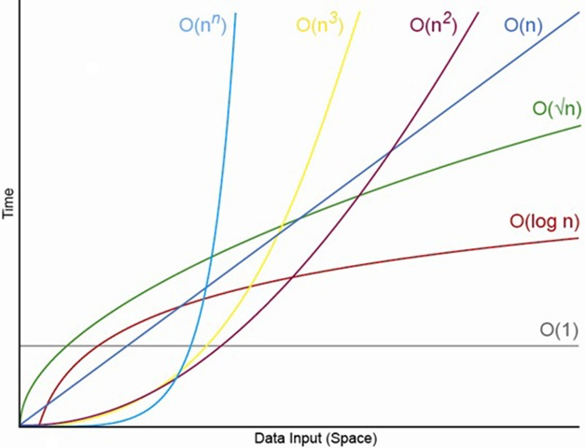
Big O Comparisons

Slide 78
Data Structures

Slide 79
Data Structures? (Tricky Question)
What is a data structure?
(And what is an example?)

Slide 80
Data Structures? (Tricky Question)
Before we answer that…

Slide 81
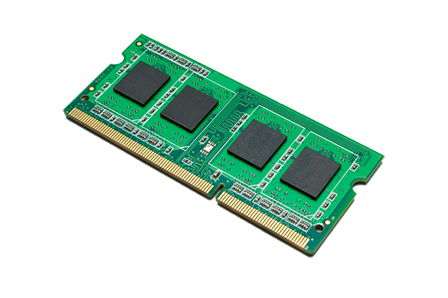
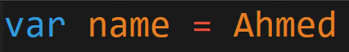
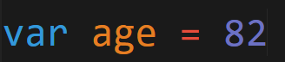
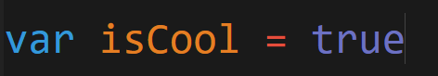
Code = Data. Data Is Saved.
Code that we write gets saved in memory.

Slide 82
Different Ways to Save
Memory can be visualized as slots. Data is then allotted to these slots.
 |  |  | Bank 3 |  | Bank 2 |  | Bank 1 |  | Bank 0
 |  |  |  |  |  |  |  |  |  | OxOOOC
 |  |  |  |  |  |  |  |  |  | Ox0008
 |  |  |  |  |  |  |  |  |  | 0x0004
 |  |  |  |  |  |  |  |  |  | 0x0000
 | 07 data bus D0 |  | D31 data bus (one memory cycle) D0
 | Byte Addressable Memory |  | Banked Memory

Slide 83
Memory on My Mind
Our code as a whole takes some of these slots of memory.
Our variable data itself also takes slots of memory.
My Program (executable) |  | Program's Virtual Memory | Mapping | Physical Memory
int min=10; int max - 50; Int main () { }
 |  | Program Code
 | &min &max
 |  | Program Data
SS
SS
SS
SS
SS
SS

Slide 84
Saving to Memory
Each time we declare or instantiate a variable, we are saving that data to memory.
 | Code |  |  |  |  |  | Memory
 | var num1 = 50; var num2 = 25; |  |  |  |  |  | 50
 |  |  |  |  |  |  | 25

Slide 85
Retrieving from Memory
When we reference these variables in our code, we are retrieving the data from memory.
 | Code |  |  |  |  |  | Memory
 | var num1 = 50; var num2 = 25; |  |  |  |  |  | 50
 |  |  |  |  |  |  | 25
 | console.log(num1 + num2);

Slide 86
Growing Data = Growing Problem
As applications grow and we begin to incorporate larger quantities of information with inter-relationships.
These simple operations of saving, retrieving, etc.
Become a lot more intensive (both time-wise and CPU-processing-wise).
Don’t let the simplicity fool you!

Slide 87
Building Devices
Devices inherently have limited memory because of space requirements—making efficiency decisions critical.
You have limited space. Use it wisely!

Slide 88
Retrieving from Memory
Even simple objects require memory to keep track of numerous relationships.
 | Code
 | var pet = { type: "Mammal", animal: "Cat" name: "Sammy", age: 24 }
Memory
pet
Mammal
type
Cat
animal
Sammy
name
24
age

Slide 89


Q
A
What is a data structure?
A way of storing data so that it can be used by a computer.

Slide 90
Q
A
What is a data structure?
They are built upon simpler primitive data types (like variables)

Slide 91
Q
A
What is a data structure?
It is non-opinionated, in the sense that it is only responsible for holding the data.

Slide 92
Data Structures?
Example Data Structure: Arrays
var favFoods ["Pickles", "Onions", "Carrots"]

Slide 93
Arrays

Slide 94
Arrays!
Arrays are the simplest data structure.
JavaScript includes it natively.
In most languages, arrays do not allow mixing of types.
In most languages, arrays are not extendable. (They are fixed sizes.)
var averageTemp = [];
averageTemp[0] = 31.9;
averageTemp[1] = 35.3;
averageTemp[2] = 42.4;
averageTemp[3] = 52;
averageTemp[4] = 60.8;
 | 31.9 | 35.3 | 42.4 | 42.4 | 60.8 | ...
 | [0] | [1] | [2] | [3] | [4]
averageTemp

Slide 95
Arrays in JavaScript
In most languages (non-JavaScript), arrays are immutable—meaning that upon declaration, the length of the array is fixed.
With JavaScript, we can easily add elements using the .push() method.
Q
.push adds elements to which side of the array?
31.9 | 35.3 | 42.4 | 42.4 | 60.8
[0] | [1] | [2] | [3] | [4]

Slide 96
Arrays in JavaScript
In most languages (non-JavaScript), arrays are immutable—meaning that upon declaration, the length of the array is fixed.
With JavaScript, we can easily add elements using the .push() method.
Q
.push adds elements to which side of the array?
31.9 | 35.3 | 42.4 | 42.4 | 60.8
[0] | [1] | [2] | [3] | [4]

Slide 97
Arrays in JavaScript
Q
How can we add an element to the beginning of the array?
31.9 | 35.3 | 42.4 | 42.4 | 60.8
[0] | [1] | [2] | [3] | [4]
How would you solve this without a built-in Array method?

Slide 98
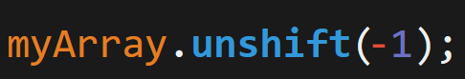
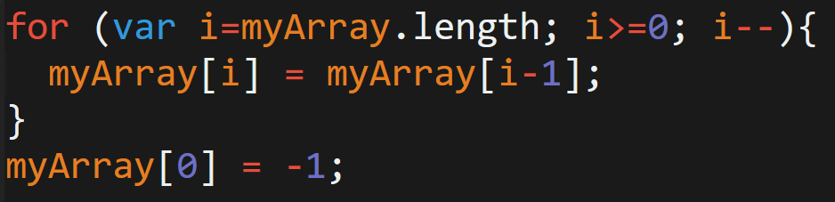
Arrays in JavaScript
Unshift method:
What’s really happening:

Slide 99
Arrays in JavaScript
An inefficiency emerges!
0 | 1 | 2 | 3 | ... | 11 | 12 | 13 | ...
[0] | [1] | [2] | [3] | [...] | [11] | [12] | [13] | [14]
 |  |  |  |  |  |  | [length = 14]
-1 | 0 | 1 | 2 | ... | 10 | 11 | 12 | 13
[0] | [1] | [2] | [3] | [...] | [11] | [12] | [13] | [14]
 |  |  |  |  |  |  | [length = 15]

Slide 100
Arrays in JavaScript
An inefficiency emerges! We’ll come back to this.
0 | 1 | 2 | 3 | ... | 11 | 12 | 13 | ...
[0] | [1] | [2] | [3] | [...] | [11] | [12] | [13] | [14]
 |  |  |  |  |  |  | [length = 14]
-1 | 0 | 1 | 2 | ... | 10 | 11 | 12 | 13
[0] | [1] | [2] | [3] | [...] | [11] | [12] | [13] | [14]
 |  |  |  |  |  |  | [length = 15]

Slide 101
Stacks/Queues

Slide 102
Data Structures = Abstractions Going forward, treat each of the following data structures as concepts. These are paradigmatic ways of organizing data that are commonly seen in code.

Slide 103
Stacks
Stacks are another common data structure.
They are similar to arrays in that they are a sequenced order of numbers.
20
14
12
1
The difference is they only allow access to the top element.
These data structures obey LIFO (Last-in-first-out). This means that new elements are placed at the top and removed from the top.
Stacks are an abstraction of how data can be arranged.

Slide 104

Stacks
Stacks are another common data structure.
They are similar to arrays in that they are a sequenced order of numbers.
The difference is that they only allow access to the top element.
These data structures obey “LIFO” (last in, first out). This means that new elements are placed at the top and removed from the top.
Stacks are an abstraction of how data can be arranged.

Slide 105
Stacks
Last in First Out: Items added to the top. Removed from the top
 |  |  |  |  |  | top
 |  |  |  | top |  | 15
 |  | top | push 11 | 11 | push 15 | 11
 | push 8 push 5 | 8 |  | 8 |  | 8
empty stack |  | 5 | base | 5 | base | 5 | base

Slide 106
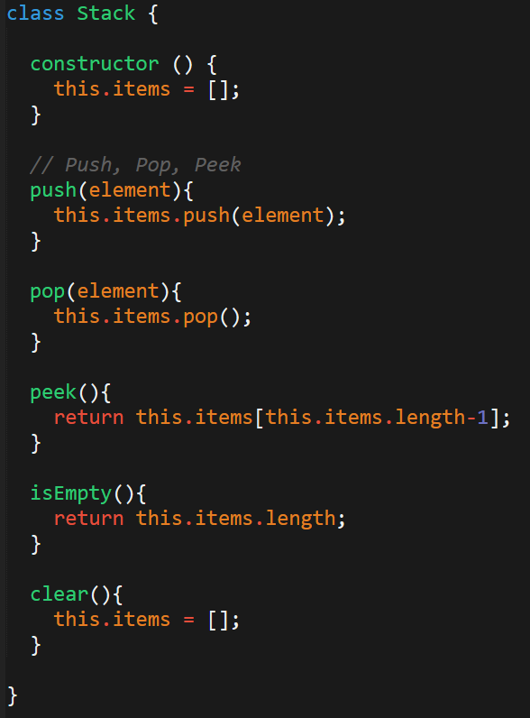
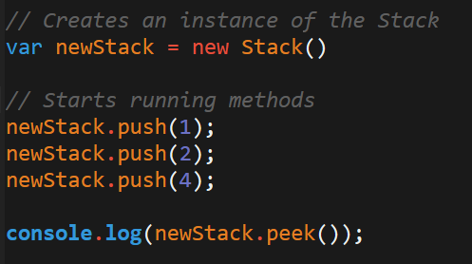
Stacks: In Code
“Stacks” aren’t supported natively in JavaScript.
To utilize this structure, one needs to create the class themselves.
Once you’ve created a class you can create and utilize these structures in your code.

Slide 107
Queue
Queues are another common data structure.
They are similar to arrays in that they are a sequenced order of numbers.
20
14
12
1
The difference is they only allow access to the first element.
These data structures obey FIFO (first in, first out). This means that new elements are placed at the “back” but that the “first” element is removed from the front.
Queues are an abstraction of how data can be arranged.

Slide 108

Queue
Queues are best remembered as similar to a movie queue. The first one in line is the first one to enter (or exit).
Notes:
AdobeStock_35633855.png

Slide 109
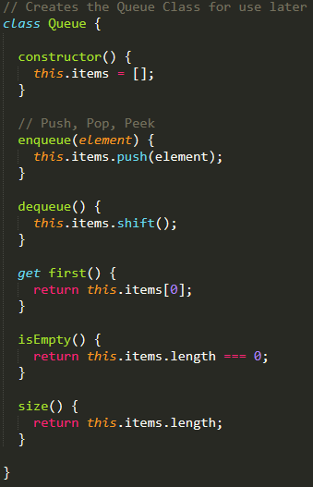
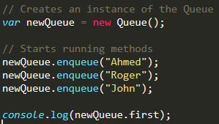
Queue: In Code
“Queues” aren’t supported natively in JavaScript.
Again, this means we need to create our own.
Queues provide two common methods: enqueue and dequeue.
Notes:
This is a terrible queue. It should be implemented with LinkedList

Slide 110
Linked Lists

Slide 111
Arrays in JavaScript
An inefficiency emerges! We’ll come back to this.
0 | 1 | 2 | 3 | ... | 11 | 12 | 13 | ...
[0] | [1] | [2] | [3] | [...] | [11] | [12] | [13] | [14]
 |  |  |  |  |  |  | [length = 14]
-1 | 0 | 1 | 2 | ... | 10 | 11 | 12 | 13
[0] | [1] | [2] | [3] | [...] | [11] | [12] | [13] | [14]
 |  |  |  |  |  |  | [length = 15]

Slide 112
Linked Lists
Linked lists are data structures in which each element of the list is sequentially joined to the next element.
The major difference is that the list elements are not stored contiguously in memory (i.e., they fall in different memory slots).
These linked lists keep track of the position of elements using pointers, which explicitly point to the “connected item.”
Each element (called a node) tracks both the item’s and the next item’s position.
node
node
node
null
item
next
item
next
item
next
head

Slide 113
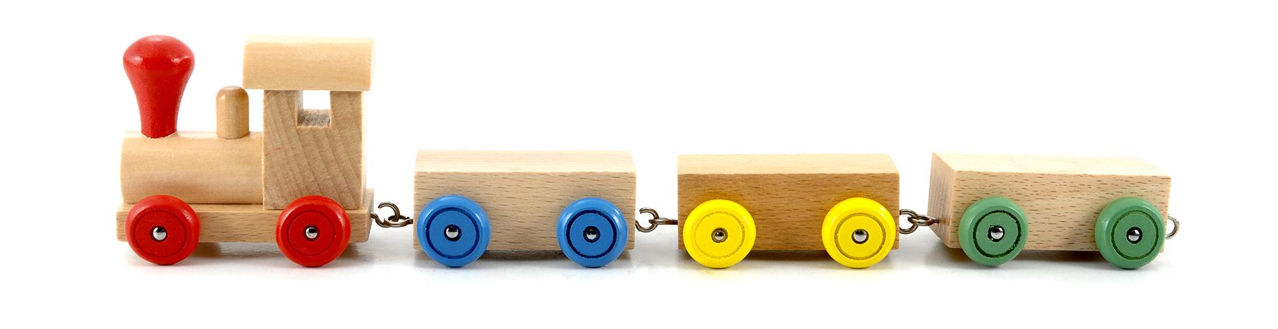
Linked Lists
Linked lists are like trains.
Each car in the train not only knows its own position but it also knows the position of the car in front of it.
Notes:
AdobeStock_42341636

Slide 114
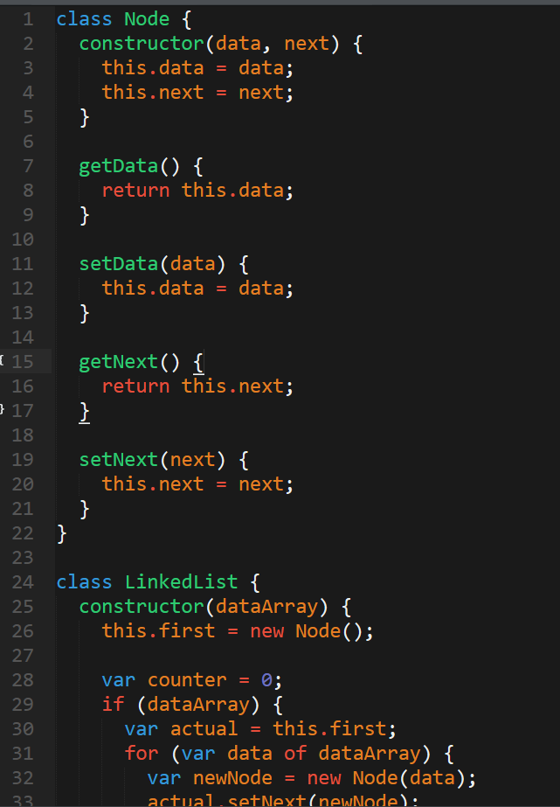
Linked List: In Code
JS does not include linked lists natively, but when you need one, plenty of implementations are available online.

Slide 115
Pulse Check

Slide 116
You Be the Teacher
To the person next to you, explain each of the following concepts:
What is a data structure?
What does FIFO and LIFO stand for and mean?
What is a stack?
What is a queue?
What is a linked list?
How are they each different from arrays?
What is one disadvantage of an array?
Most important question: why are we doing all this again?

Slide 117
Dictionaries (Maps)

Slide 118
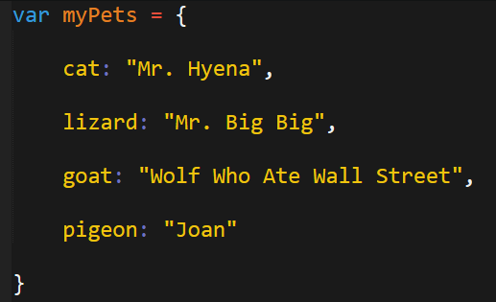
Dictionaries (Maps): Actually Useful
Dictionaries are an incredibly important data structure. In fact, they address a common situation you’ve faced in this class.
Q
How would you print all the pet names?

Slide 119
Dictionaries (Maps): Actually Useful
Dictionaries are an incredibly important data structure. In fact, they address a common situation you’ve faced in this class.
Q
How would you print all the pet names?
Arrays don’t solve the problem either:

Slide 120
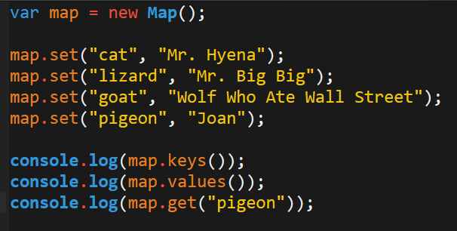
Dictionaries (Maps): Actually Useful
The solution is to use a dictionary (map).
In a way, dictionaries are like a hybrid of objects and arrays.
They can be iterated over like arrays.
They have key, value pairs like objects.
They’re included in JavaScript ES6.
BIG DEAL!

Slide 121
Learn More About Dictionaries (Maps) in JS:
developer.mozilla.org/en-US/docs/Web/JavaScript/Reference/Global_Objects/Map

Slide 122
Trees
Notes:
Going to come back to trees on Saturday

Slide 123
Trees
Trees are a favorite data structure for computer scientists
Trees are a non-sequential data structure made of parent-child relationships.
The top node of a tree is the root.
Trees have internal nodes and external nodes.
Each node has ancestors and descendants.
Kind of like a linkedlist

Slide 124
Binary Trees
Binary Trees / Binary Search Trees (BST) are particularly useful
In a Binary Search Tree:
In a binary tree, nodes have two children at most: one on the left and the right.
Left-hand side is lesser number; right-hand side is the larger
Paradigm makes it easy to insert, search, and delete from tree

Slide 125
Binary Trees
Binary search trees are efficient for searching, insertion and deletion.
11
7
15
5
9
13
20
3
6
8
10
12
14
18
25

Slide 126
Binary Search Trees
npmjs.com/package/binary-search-tree

Slide 127
Activity: Let’s Build This!
Take a few moments to build a binary search tree with those around you. As a suggestion, implement the following tree. Then run a search for any number in the tree.
11
7
15
5
9
13
20
3
6
8
10
12
14
18
25
Notes:
Just draw one

Slide 128
Graphs
Notes:
Will talk about on Saturday

Slide 129

Graphs
Graphs are extremely powerful and increasingly common structures.
Graphs are abstract models of a network structure. They are a set of nodes (or vertices) connected by edges.
They are the essence of social networks and geographic maps.
JFK
SFO
STL
LAS
DFW
MIA

Slide 130

Graphs
But through graphs and “shortest-path” algorithms we can build map applications like the ones found on Google Maps.
Notes:
shutterstock_461093119

Slide 131
Back to Projects!

Slide 132
Questions?

